Slide 1
Political Analysis:
Introduction
and
Research Design
Week 1
15 January, 2018
Prof. Andrew Eggers

Slide 2
Our aims
Improve your ability to assess evidence on empirical questions.
Give you the tools to do your own data analysis.

Slide 3
Assessing evidence on empirical questions
For example:
Does first-past-the-post discourage political engagement compared to other electoral systems?
Do majority-Islamic countries have worse human rights records, controlling for wealth and other factors?
Does satellite technology help avoid interstate wars?
Does decentralization of the political system change its political culture? (Prelims specimen exam paper)
What causes party systems to change over time? (Prelims specimen exam paper)
What explains the rise of populism in advanced democracies? (Prelims specimen exam paper)

Slide 4
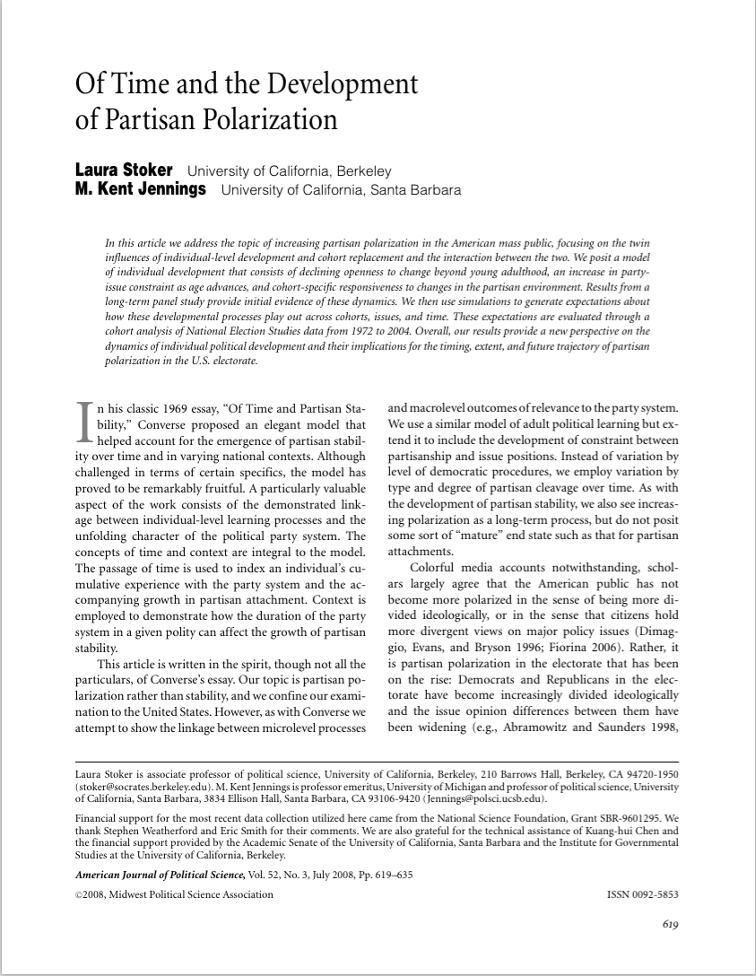
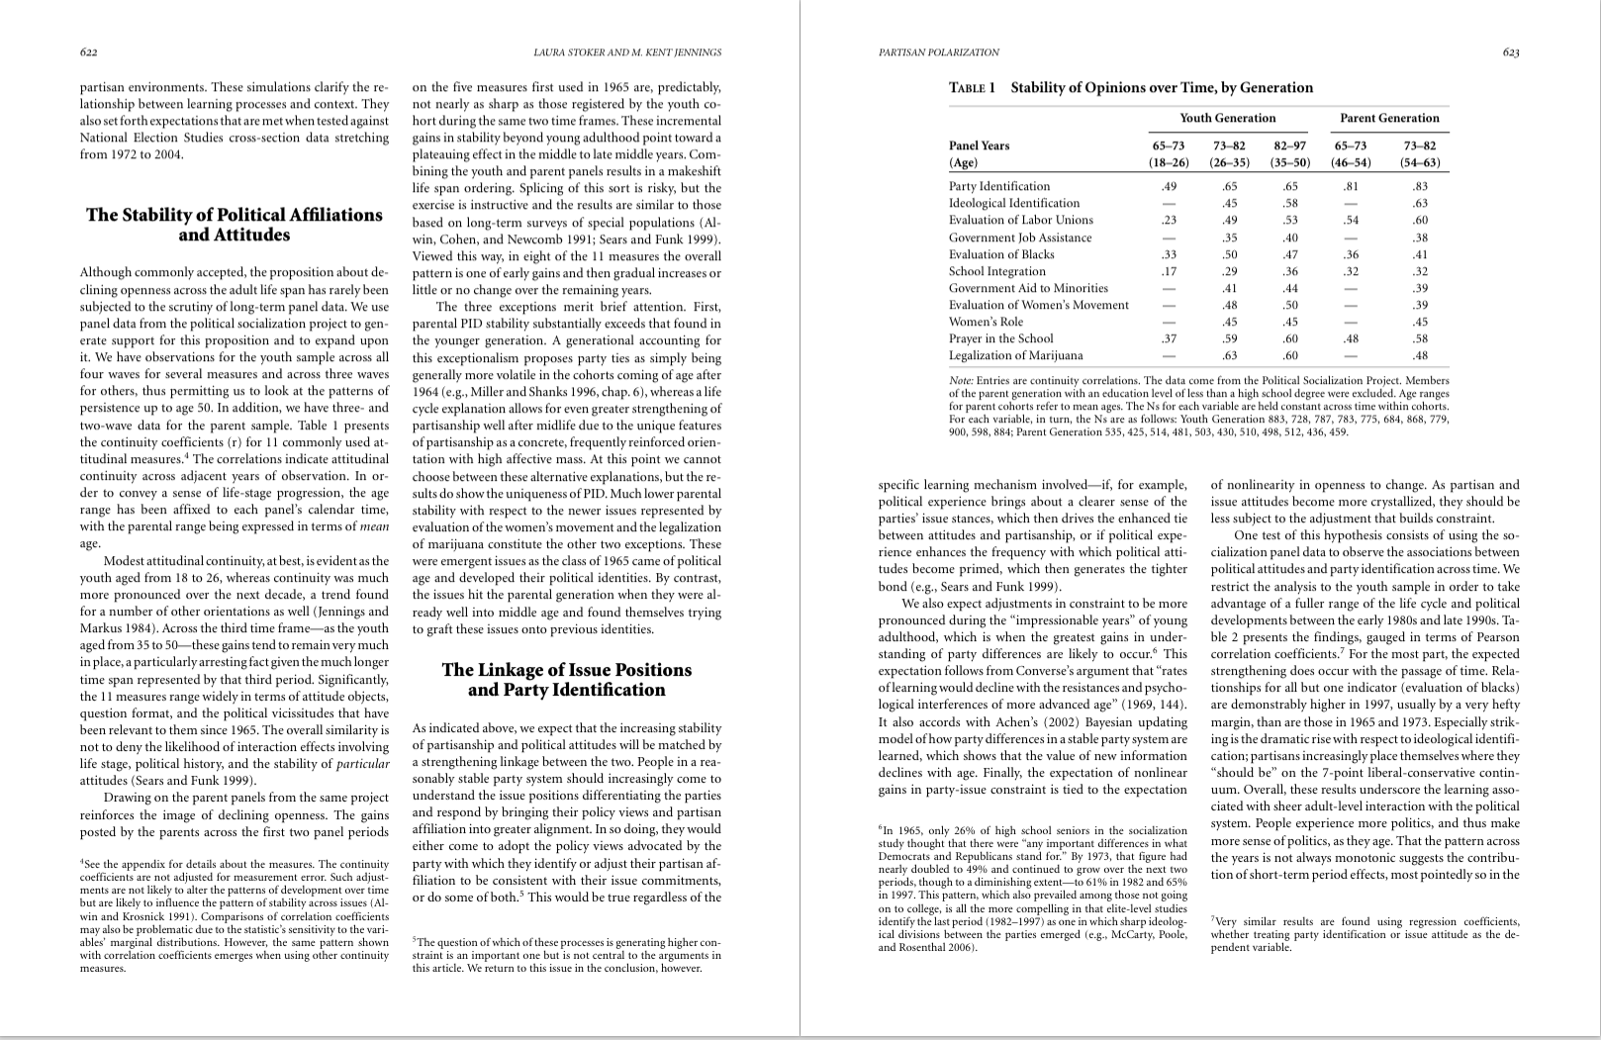
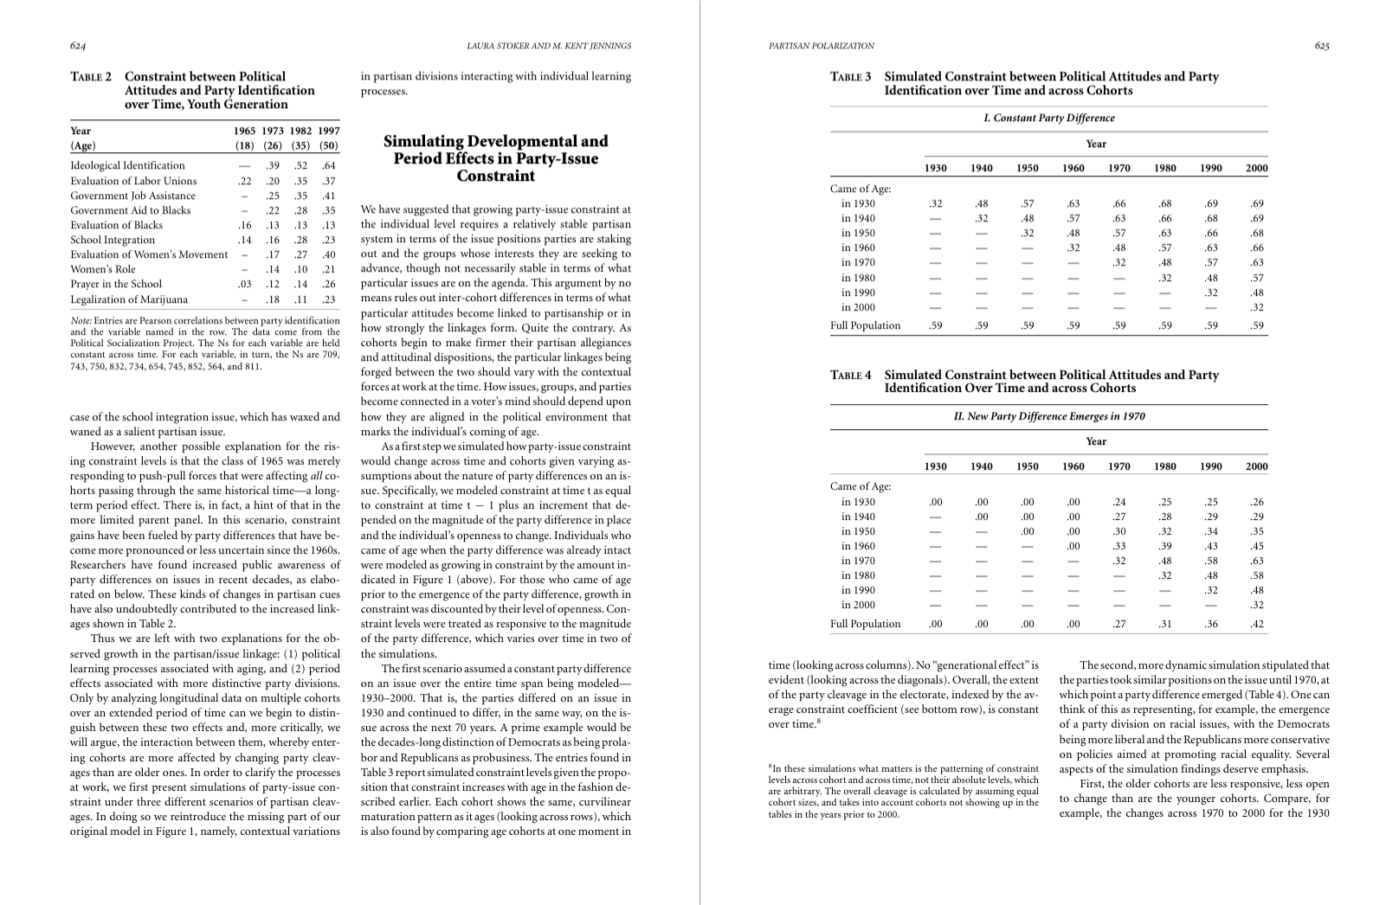
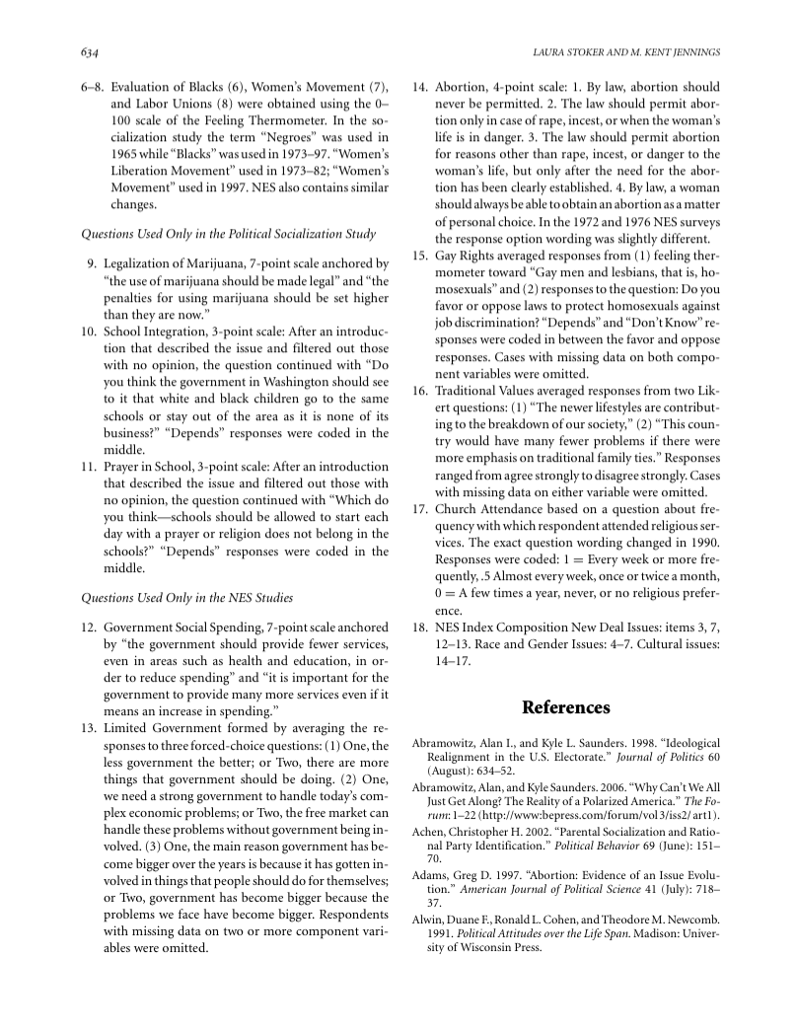

Slide 6
Assessing evidence better: exams and essays
Explain the basis of empirical evidence you cite.
“Evans and Tilley say X, but Fisher says Y”
“Evans and Tilley’s regression analysis of the British Election Study indicates X, but Fisher (using the same data) says Y once we properly control for age and education”
Assess the empirical evidence you cite.
“Evans and Tilley say X.”
“Evans and Tilley say X, but their analysis does not account for important factors . . .”
“Evans and Tilley say X, but their analysis only indirectly addresses the question because . . .”
“Evans and Tilley say X, and their analysis is particularly credible because. . .”

Slide 7
Assessing evidence better: the rest of your life

Slide 8
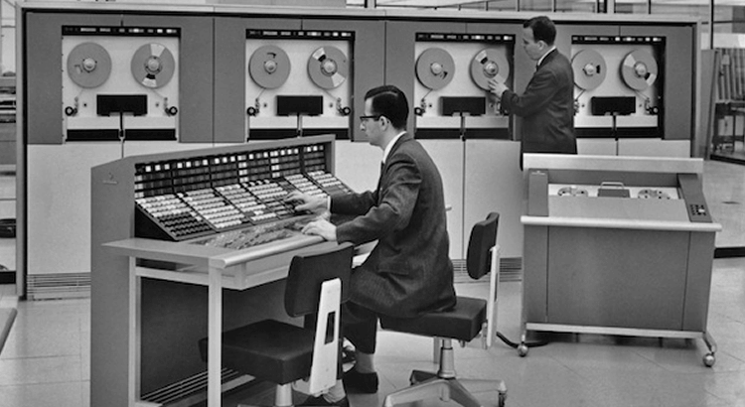
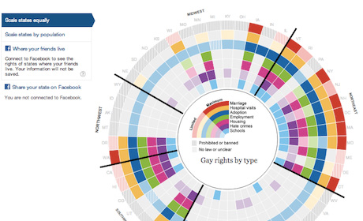
Doing your own data analysis
Then: Data hard to get and (learn to) process; only specialists did data analysis
Now: Data easy to get and (learn to) process; everyone can do data analysis

Slide 9
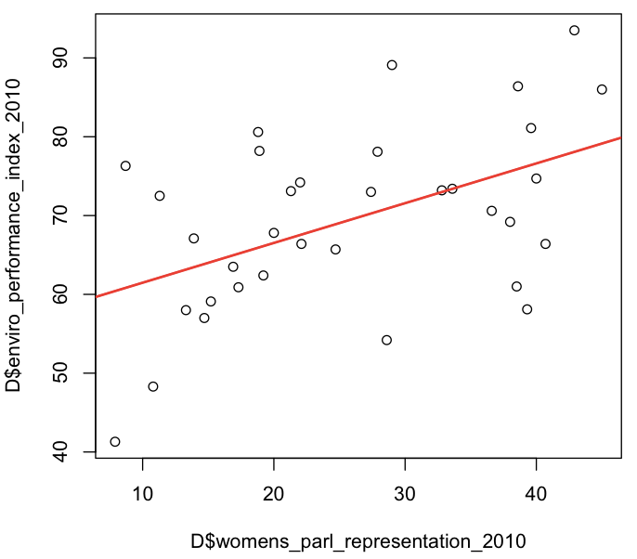
What you’ll learn

Slide 10
Why should I learn to do my own data analysis?
To better assess evidence
To produce your own evidence: tutorial essay, research paper, dissertation, beyond
To get a job, or do more interesting things at a job: “the intern who stopped making coffee”
You may not know yet why!

Slide 11
Political Analysis: a snapshot
Lectures by week:
Introduction and Research Design (AE)
Concepts and Measurement (AR)
Descriptive Statistics and Visualization (AR)
Case Selection (RH)
Bivariate Relationships (AE)
Multivariate Relationships (AE)
Inference (AE)
Synthesis and Review (RH)
Data labs by week:
2. R basics
4. Descriptive statistics
6. Regression analysis 1
8. Regression analysis II
For the time & location of lab sessions, see email from PPE office.
Lecturers:
Assessment: 2000-word essay (on one of three questions related to Lijphart’s claims about effects of consensus democracy) to be submitted by 12 noon Tuesday 1 May 2018
Andrew Eggers
Andrea Ruggeri
Robin Harding

Slide 12
You won’t understand what you’re doing in the labs or the essay assignment unless you attend the lectures and/or read the textbook.

Slide 13
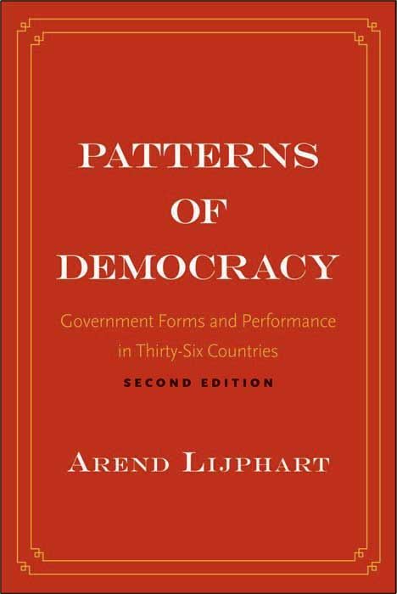
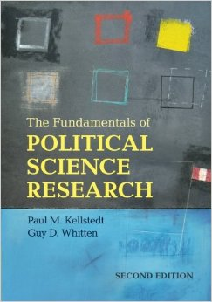
Books in the course
Main concepts, techniques
Thematic context in which to apply those ideas

Slide 14
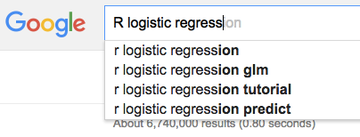
Software in the course
The programming language we will use
The user interface we will use (the program you should download)
One way to get help when you’re stuck

Slide 15
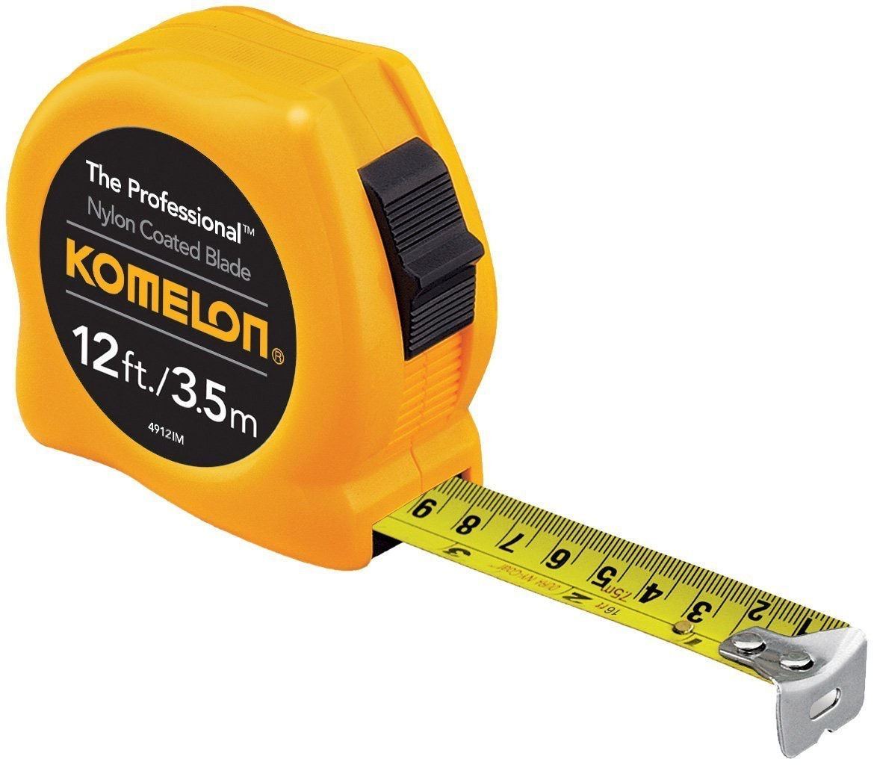
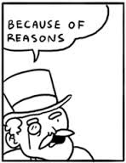
A typology of research questions
Descriptive questions:
What proportion of UK citizens support leaving the EU?
Do democracies have better human rights records than non-democracies?
Explanatory questions (reverse causal questions):
Why do democracies seldom fight wars against each other?
Why are incumbent legislators so likely to win re-election?
What caused the French revolution?
Forward causal questions:
What is the effect of campaign spending on election outcomes?
What is the effect of consensus democracy on political stability?
X
Y

Slide 16
Research design for descriptive questions
Consider this question: “Is respect for human rights higher in democracies than in non-democracies?”
Requires
defining concepts (democracy, respect for human rights), deciding on a procedure for measuring them (Week 2)
communicating the resulting measures (Week 3) and their relationship (Week 5)

Slide 17
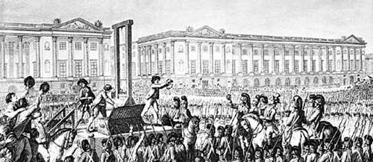
Characteristics of reverse causal questions (“why” questions)
Some start from a single event and seek to explain why it happened.
Potential causes
An event: the French revolution
Bad harvests
The Enlightenment
War debts

Slide 18
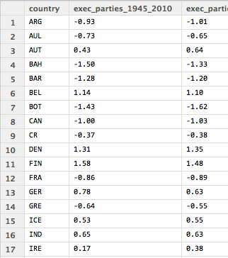
Characteristics of reverse causal questions (“why” questions) (2)
Others start from a pattern and seek to explain why it holds.
A pattern:
democracies tend not to fight one another
Potential explanations
Economic development
Education and values
Popular sovereignty

Slide 19
How do we assess explanations?
A good explanation
is, or would have been, useful for prediction
includes an account of how the causes produced the effects (mechanisms, or theory)
converts a puzzle into a “matter of course” (Peirce, 1903) [inevitability]
is “hard to vary” (Deutsch, 2011), i.e. doesn’t work if you alter elements of it
For more on answering explanatory questions, see Andrew Gelman and Guido Imbens, “Why ask why? Forward causal inference and reverse causal questions”, unpublished manuscript 2013.

Slide 20
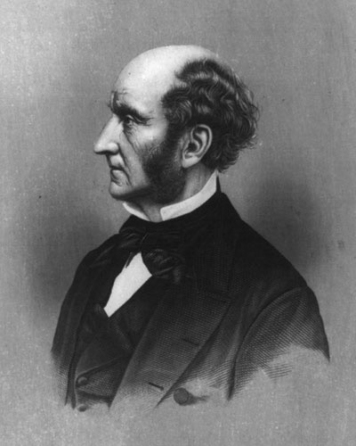
Mill and reverse causal questions
Mill’s methods clarify why explanation in the social sciences is messy.
John Stuart Mill
A System of Logic (1843)

Slide 21
Suppose all of the potential causes can be enumerated and accurately measured. Then these two methods will in certain circumstances tell us the cause of an outcome:
Method of agreement
Method of difference
Case A
Case B
A
B
Outcome
Outcome
(i)
(ii)
Potential
causes
Potential
causes
(iii)
(iv)
The
cause!
The
cause!
(v)
Reverse causal inference from just two cases!!!

Slide 22
Problems with applying Mill’s methods in social science research
What if there is more than point of agreement or difference?
How do you know if you have listed all of the potential causes?
How do you judge agreement when factors are not binary?
What if there is measurement error or randomness?
What if two causes both need to be present?
Method of agreement
Method of difference
“. . . in the sciences which deal with phenomena in which artificial experiments are impossible (as in the case of astronomy), or in which they have a very limited range (as in mental philosophy, social science, and even physiology), induction from direct experience is practiced at a disadvantage in most cases equivalent to impracticability.” (Mill, A System of Logic)
Case A
Case B
A
B
Outcome
Outcome
Potential
causes
Potential
causes

Slide 23
Answering reverse causal questions in a messy world
There are important phenomena we don’t know or can’t observe.
=> Mill’s methods can’t be applied. (He knew that!)
Explanations in social science will be messy & contested.

Slide 24
Research design for reverse causal questions
Types of explanations:
Theoretical: “I offer a theory that shows how the observed pattern is actually not puzzling at all.”
Empirical: “I produce a new measure of [democracy, spending, public opinion] that shows how the observed pattern is not puzzling at all.”
Combination of theoretical and empirical: e.g. “Democracies do not fight each other considerably less than would be expected when you consider their wealth.”
In social science, there can be many “good” explanations for a phenomenon and no clear way to choose one.

Slide 25
Forward causal questions: What is the effect of X on Y?
X
Y
We think in terms of counterfactual scenarios.
what would
have happened
if I had taken the aspirin?
(treatment)
what would
have happened
if I had not taken the aspirin
(control)
vs
Fundamental problem of causal inference (Holland, 1986):
We only ever observe one of these for any particular individual.

Slide 26
Fundamental problem of causal inference (1)
X
Y
Consider these forward causal questions:
Does aspirin relieve headaches?
Does a job training program increase participants’ income?
Do door-to-door campaigns increase voter turnout?
Does consensus democracy increase political stability?
How does the fundamental problem of causal inference apply?
Could we measure the effect with a “before-and-after” comparison?

Slide 27
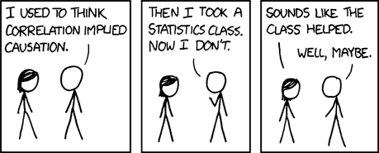
X
Y
Fundamental problem of causal inference (2)
http://xkcd.com/552/

Slide 28
The problem with the before-and-after design
X
Y
What we observe:
outcomes before and after
he took statistics
What we don’t observe:
outcomes after
he did not take statistics
Took statistics
Possible counter-factual outcomes
Belief that correlation implies causation
Belief that correlation implies causation
Actual outcome
Did not take
statistics
Before
After
Before
After

Slide 29
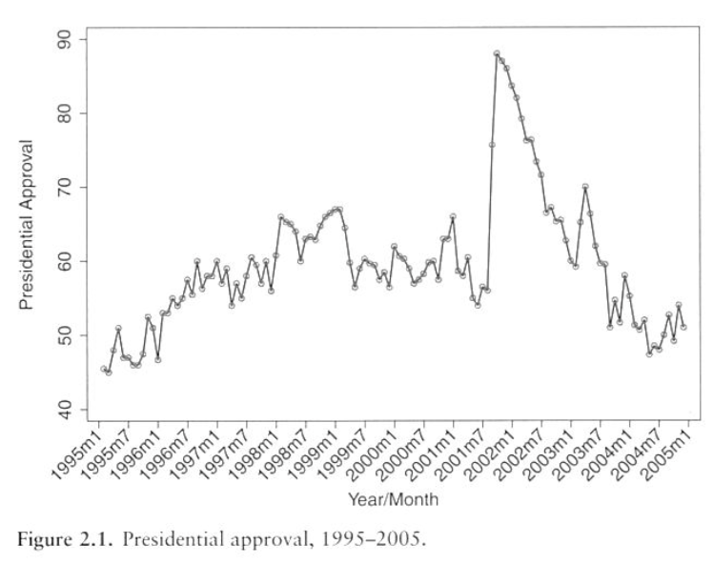
But sometimes the “before-and-after” design is convincing!
X
Y
When I flipped the light switch, the light turned on.
Approval rating of U.S. President, from Kellstedt and Whitten p. 28)
George W Bush approval rate before 9/11 57%; after 88%.
Why is it convincing in these cases?

Slide 30
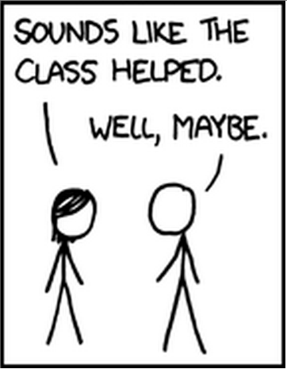
Dealing with the fundamental problem of causal inference
X
Y
We make comparisons among outcomes we do observe
and
we clearly state the assumptions
under which our comparisons will give the right answer.
Yes, under the assumption that my beliefs about correlation and causation would not have changed, had I not taken statistics.
http://xkcd.com/552/

Slide 31
What makes the “before-and-after” plausible
X
Y
Comparison: Same unit(s), before and after an intervention.
Key assumption: No change in outcome if treatment not applied.
Assumed counter-factual outcome
Outcome
Actual outcome
Before
After

Slide 32
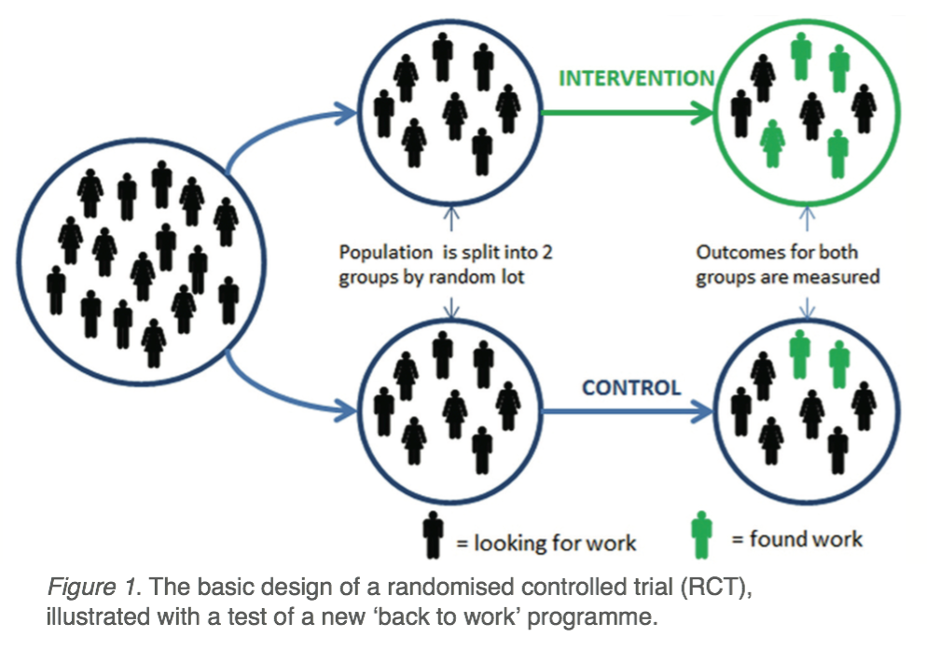
The gold standard: randomized control trial (RCT)
X
Y
How would you use an RCT to study
the effect of aspirin on headaches
the effect of a job training program on income
the effect of door-to-door campaigns on voter turnout
the effect of consensus democracy on political stability
What is the key assumption under which correlation implies causation?

Slide 33
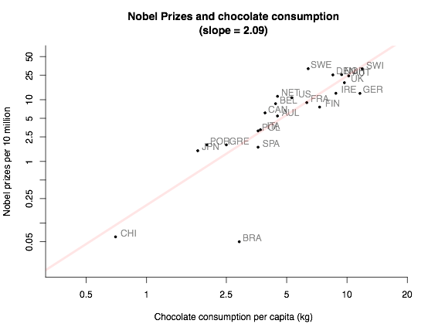
The most common design: regression analysis
X
Y
Comparison: Different units at the same point in time, possibly controlling for other variables.
(see Week 6)
Key assumption: Confounding variables (a.k.a. selection bias) are properly accounted for.

Slide 34
Implications (1)
X
Y
Every time you read an article/book in Politics (IR, Economics), ask what kind of research question is being asked:
Descriptive (what is X? what is relationship between X and Y?)
Explanatory/reverse causal (what explains/caused Y?)
Forward causal (what is the effect of X?)

Slide 35
Implications (2)
X
Y
For research addressing explanatory questions:
keep in mind the fundamental messiness, and where it comes from
note the kind of explanation (theoretical, empirical, both) being offered
For research addressing forward causal questions:
ask what RCT one could hypothetically run
note the kind of design actually used (RCT, before-and-after, regression analysis, etc), the assumptions under which correlation implies causation in this design, and ask whether these assumptions are met

Slide 36
John Stuart Mill says: social science is hard!
“Nothing can be more ludicrous than the sort of parodies on experimental reasoning which one is accustomed to meet with, not in popular discussion only, but in grave treatises, when the affairs of nations are the theme. . . . ‘How can such or such causes have contributed to the prosperity of one country, when another has prospered without them?’ Whoever makes use of an argument of this kind, not intending to deceive, should be sent back to learn the elements of some one of the more easy physical sciences.”

